Slide 1
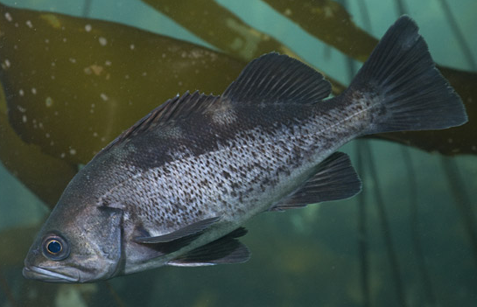
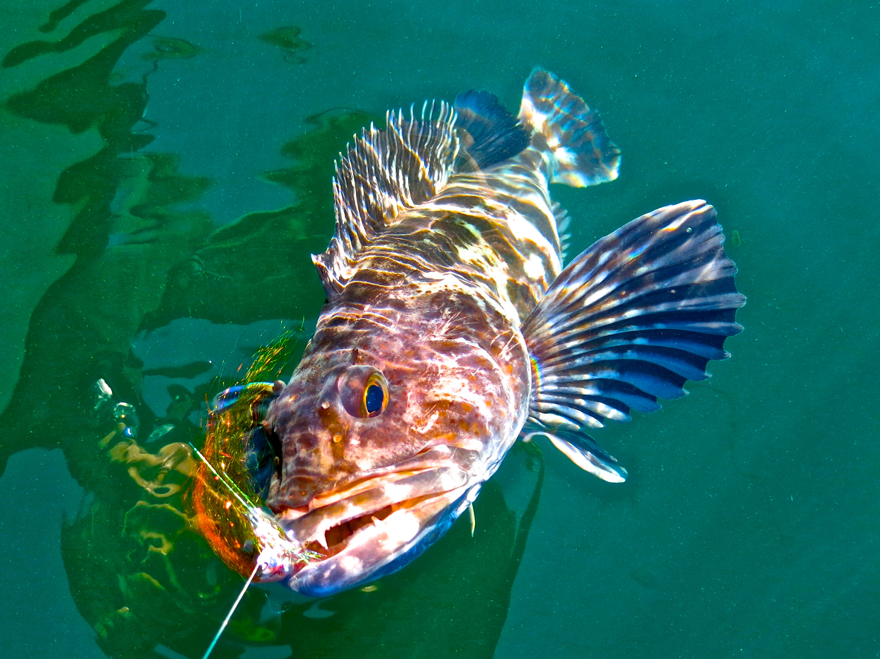
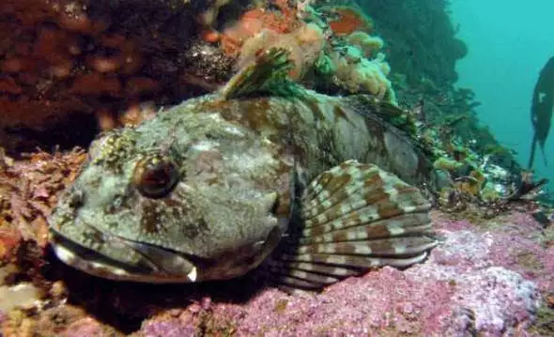
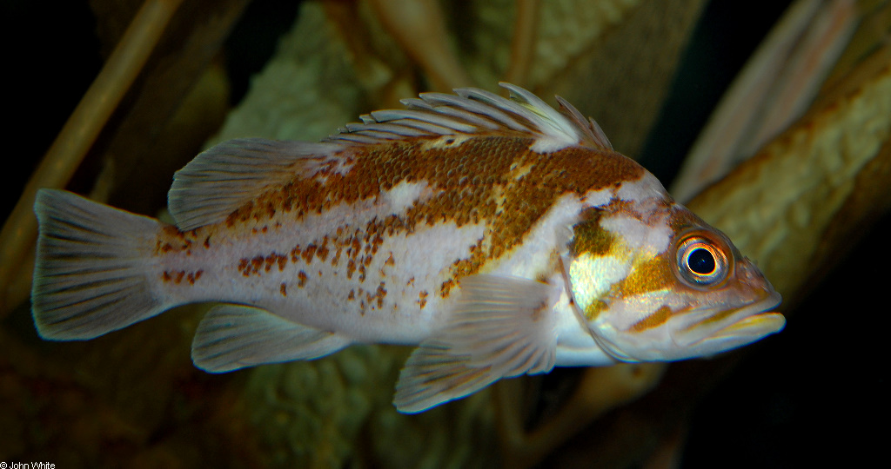
Implications of Transient Dynamics and Stochasticity for Adaptive Management of Marine Reserves
Victoria Quennessen
MS Student in Fisheries Science
IB 599: Analytical Workflows
Final Presentation
June 12th, 2019
Levi
Jay Nichols
FishWithJD
John White

Slide 2
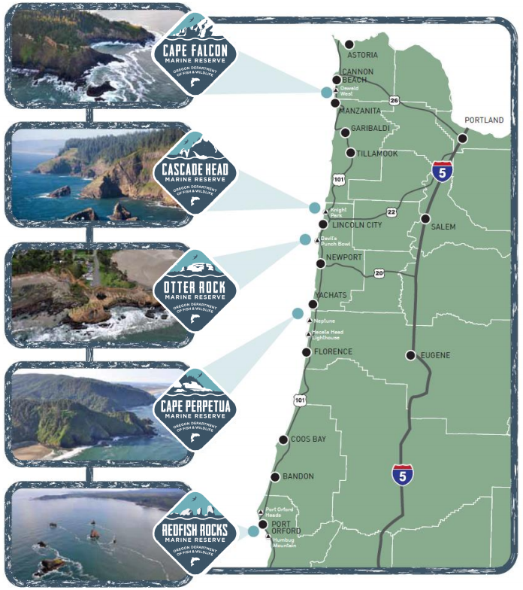
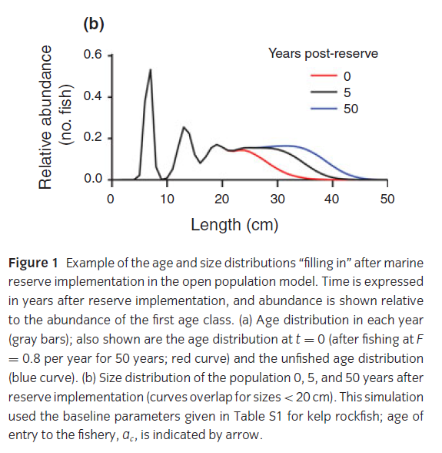
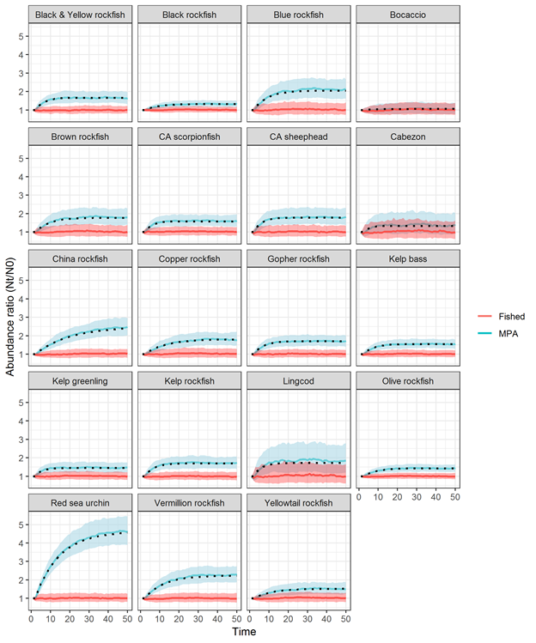
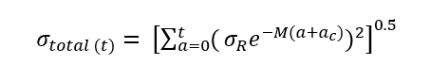
Background
Methods
Workflows
Results
White et al., 2013
Fished
Abundance Ratio (N_{t}/N₀)
MPA
Adapted from Kaplan et al., in review
Time (years)

Slide 3
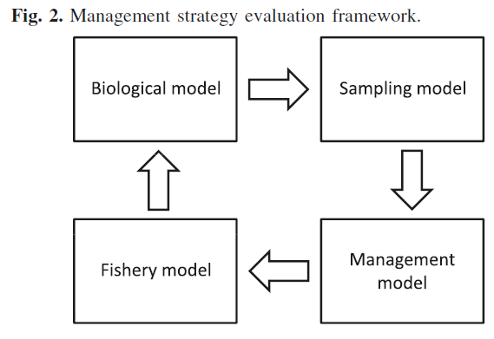
Base Model and Control Rules
Background
Methods
Workflows
Results
Density ratio as metric to assess level of depletion:
# ind./ area outside reserve
-------------------------------------
# ind./ area inside reserve
Current west coast groundfish fishery has 40-10 control rule
Babcock & MacCall 2011

Slide 4
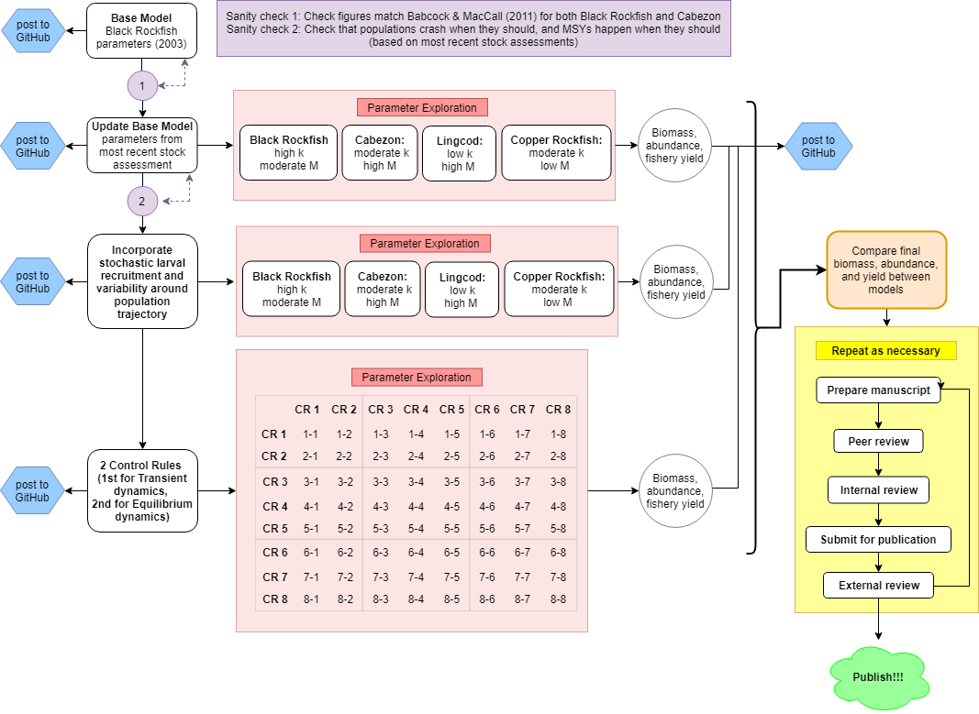



Background
Methods
Workflows
Results

Slide 5
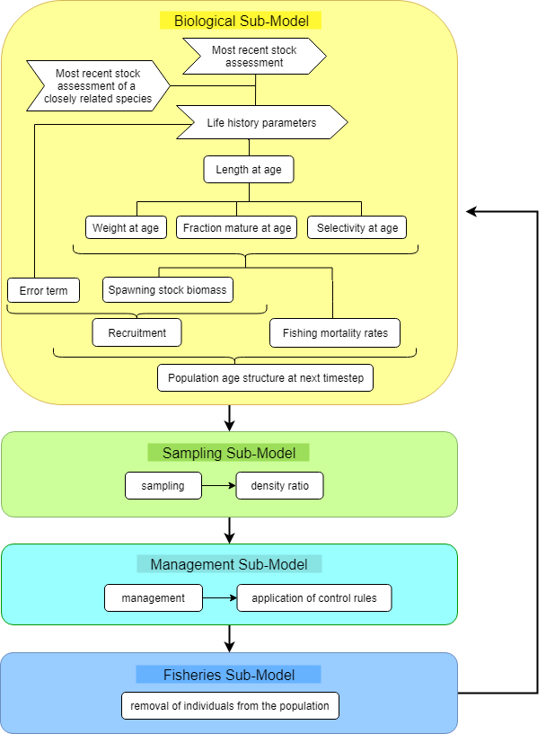
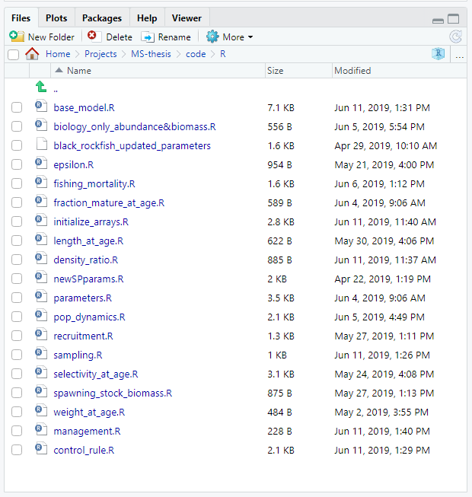
Background
Methods
Workflows
Results

Slide 6
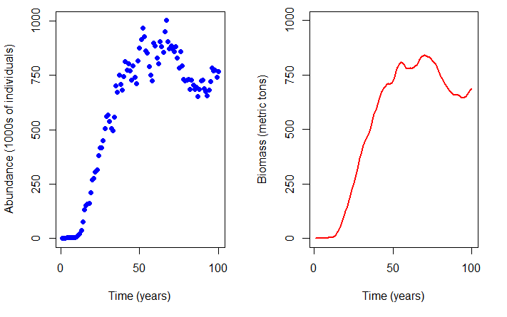
Background
Methods
Workflows
Results
Notes:
Lower mortality (M) + higher growth rates (k) = shorter timescales

